Slide 1




NEXT GEN EMPLOYABILITY PROGRAM
Creating a future-ready workforce
Team Members
College Name
Student Name: Gowtham P
Student ID :412321205008
Sri Ramanujar Engineering Collage(4123)

Slide 2

CAPSTONE PROJECT SHOWCASE
Project Title
MUSIC WEB APPLICATION USING DJANGO FRAMEWORK
Abstract | Problem Statement | Project Overview | Proposed Solution | Technology Used | Modelling & Results | Conclusion

Slide 3
Abstract
Objective: This project aims to develop a user-friendly music web application using Django, focusing on authentication, playlist management, seamless streaming, and intuitive search functionalities.
Method: Leveraging Django's framework, the project structures the backend to handle user authentication securely, manage playlists efficiently, deliver high-quality music streaming, and implement a robust search feature. The frontend is designed for an intuitive user experience, ensuring smooth navigation and interaction.
Result: The resulting music web application provides users with a seamless and engaging experience, allowing them to create personalized accounts, manage playlists effortlessly, stream music seamlessly, and discover new tracks easily through the search functionality.
Conclusion: Through the effective utilization of Django's features and functionalities, the project demonstrates the capability of the framework in building dynamic and interactive web applications tailored to the modern needs of music enthusiasts.
Source :

Slide 4
Problem Statement
The emergence of online music streaming platforms has revolutionized the way people consume music, but there remains a need for customizable, user-friendly platforms that cater to individual preferences. Existing platforms often lack features for personalized playlist management, efficient music streaming, and seamless user interaction.
Additionally, building such platforms from scratch can be daunting due to the complexities involved in managing user authentication, database integration, and multimedia content delivery.
Therefore, there is a pressing need to develop a modern web application using Django that addresses these shortcomings, providing users with a robust, secure, and intuitive platform for discovering, organizing, and streaming music seamlessly.
Source :

Slide 5
Project Overview
The project aims to develop a dynamic web application using Django, focused on providing a comprehensive solution for music enthusiasts.
The application will offer features such as user authentication, playlist management, music streaming, and search functionality.
Leveraging Django's powerful framework, the project will ensure a seamless user experience by implementing intuitive navigation, efficient data management, and responsive design.
Through the integration of modern technologies and innovative design principles, the web application will strive to become a go-to platform for users seeking personalized and immersive music experiences online.
Source :

Slide 6
Proposed Solution
In this project, we endeavor to create a cutting-edge music web application utilizing Django, a powerful web framework in Python, to cater to the evolving needs of music enthusiasts. Our primary objective is to develop a user-friendly platform that seamlessly integrates features such as secure user authentication, intuitive playlist management, high-quality music streaming, and efficient search functionality.
Leveraging Django's robust capabilities, we aim to ensure a smooth and engaging user experience, characterized by streamlined navigation, responsive design, and optimal performance across various devices.​
The proposed solution encompasses the creation of a modern and dynamic interface that prioritizes simplicity, accessibility, and personalization. Users will have the ability to register, log in securely, and manage their profiles effortlessly. Furthermore, they will be empowered to curate their own playlists, share them with others, and explore new music through a comprehensive search system.
Source :

Slide 7
To facilitate smooth music playback, the application will leverage Django's support for multimedia content delivery, ensuring a seamless streaming experience with minimal buffering and high audio quality.
Additionally, robust backend infrastructure will be implemented to handle data storage, retrieval, and management efficiently.
Regular updates and maintenance will be conducted to address any issues, incorporate user feedback, and enhance the platform's functionality and usability over time. Through iterative development and continuous improvement, we aim to establish the music web application as a premier destination for users seeking a personalized and immersive music experience online.
Source :

Slide 8
Furthermore, our project prioritizes scalability and adaptability to accommodate future growth and technological advancements in the music industry. By employing Django's flexible architecture and adhering to best practices in software development, we aim to create a platform that can easily integrate new features and adapt to emerging trends.
This forward-thinking approach ensures that our application remains relevant and competitive in an ever-evolving digital landscape.
In addition to providing an exceptional user experience, our project also emphasizes data security and privacy. We will implement robust security measures to protect user information, including encryption protocols, secure authentication methods, and regular security audits. By prioritizing the confidentiality and integrity of user data, we aim to instill trust and confidence in our platform, fostering long-term relationships with our users and ensuring their continued engagement and satisfaction
Source :

Slide 9


Technology Used
Front-end
Back-end
Source :

Slide 10
Modelling & Results
In terms of modeling, our project involves designing a comprehensive data model using Django's ORM capabilities to efficiently store and manage user, playlist, song, artist, and album data. This model ensures optimal performance and scalability as the application expands.
Regarding results, the project aims to deliver a fully functional music web application that allows secure user registration, personalized profile management, seamless music streaming, and intuitive playlist creation and discovery. Evaluation will be based on usability, functionality, and user satisfaction, with continuous updates to address any issues or feedback received.
Source :

Slide 11
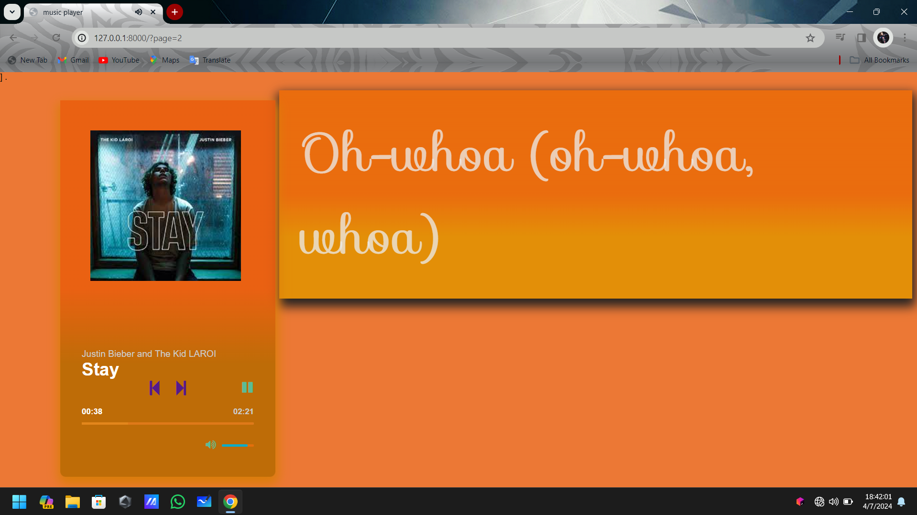
Homepage

Slide 12
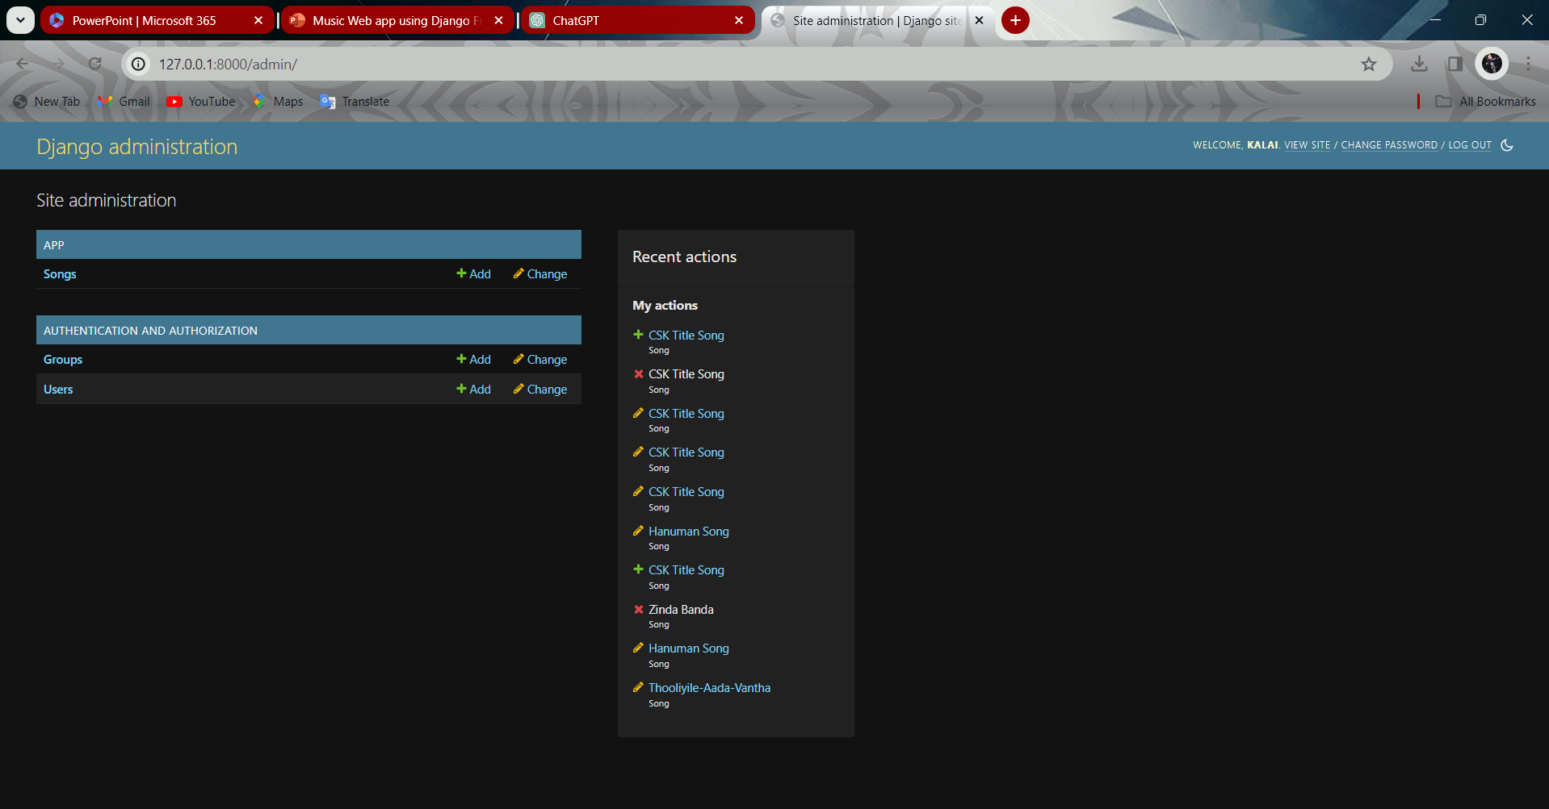
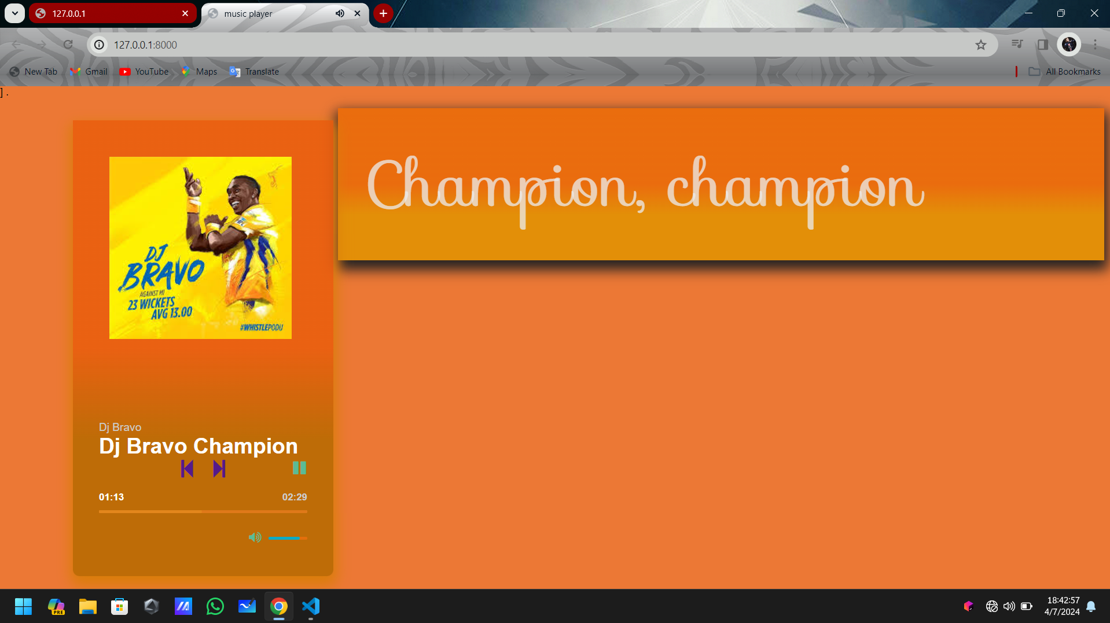
About-Us-Page
Our "About Us" page serves as a window into the team behind the music web application project.
Here, visitors can learn about our mission, vision, and the values that drive our work.
We provide a brief overview of the project's inception, highlighting the collective passion for music and technology that inspired its creation.

Slide 13
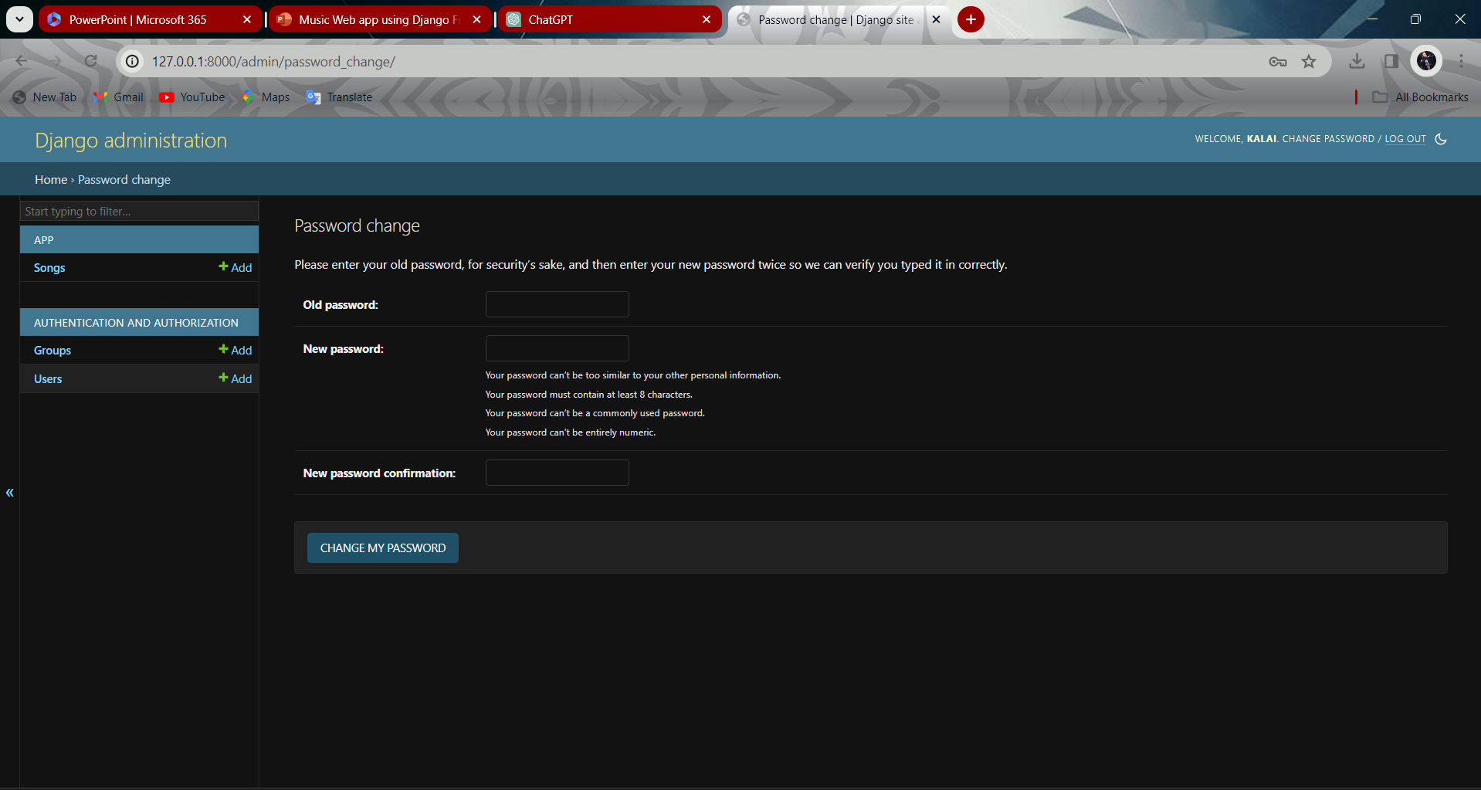
Service-Page

Slide 14
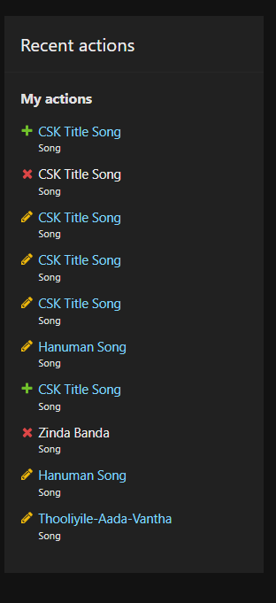
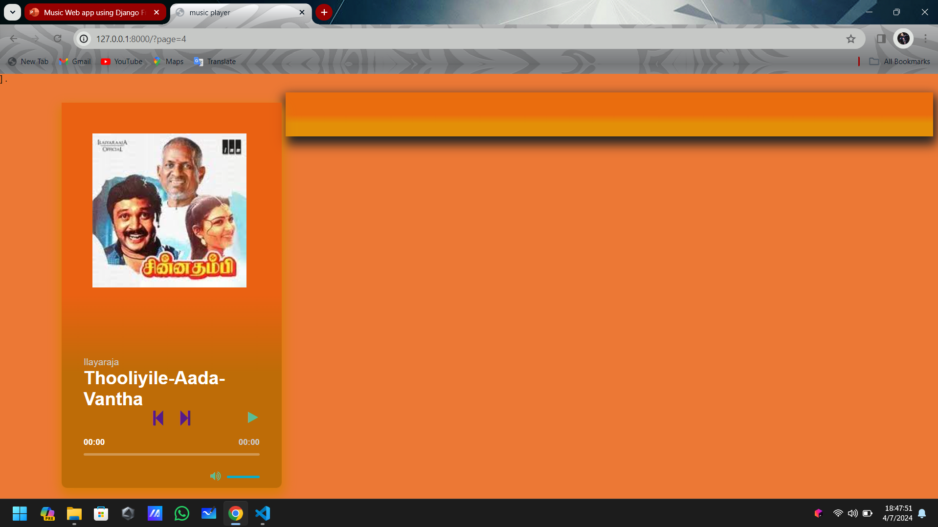
Departments-Page

Slide 15
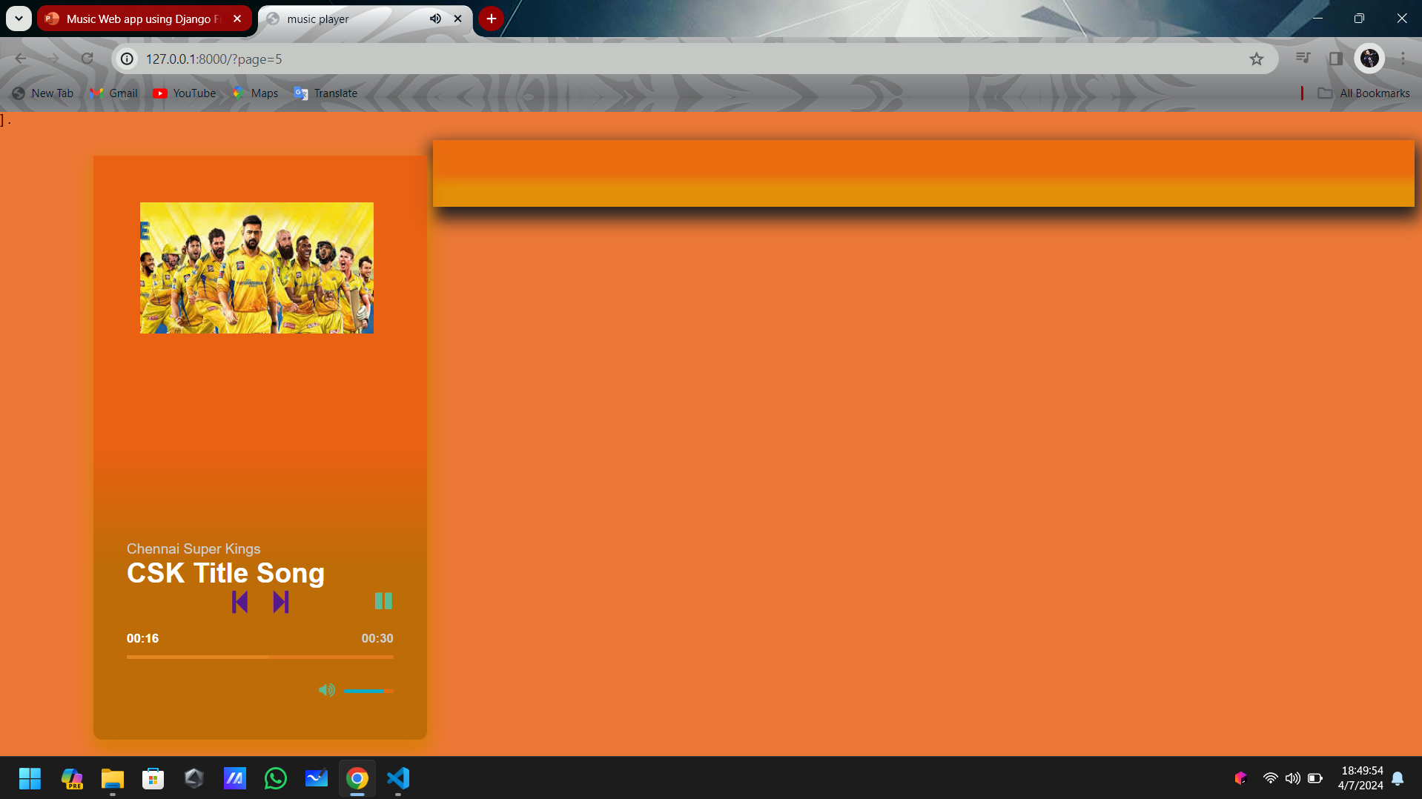
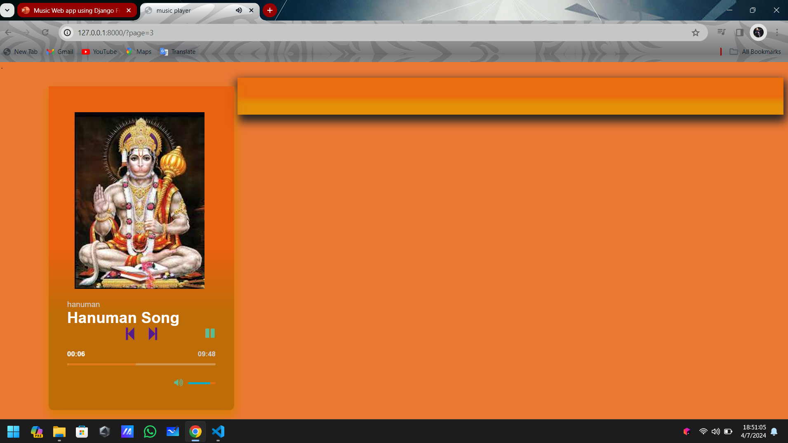
Blog-Page

Slide 16
Future Enhancements:
Future Enhancements:
Social Integration: Integrating social media features would allow users to share their favorite songs, playlists, and music discoveries with friends and followers on platforms like Facebook, Twitter, and Instagram, enhancing user engagement and promoting the platform's visibility.
Personalized Recommendations: Implementing machine learning algorithms to analyze user preferences and behavior could enable the generation of personalized music recommendations tailored to each user's taste, increasing user satisfaction and retention.
Collaborative Playlists: Introducing collaborative playlist functionality would enable users to create and curate playlists together with friends or fellow music enthusiasts, fostering a sense of community and collaboration within the platform.
Lyrics Integration: Integrating a lyrics feature that displays song lyrics alongside the music playback would enhance the user experience, allowing users to sing along, understand the meaning behind the songs, and discover new artists and songs based on lyrical content.

Slide 17
Conclusion
In conclusion, the development of the music web application using Django represents a significant step towards providing users with a seamless and immersive music listening experience. Through the implementation of features such as secure authentication, intuitive playlist management, high-quality music streaming, and efficient search functionality, the platform offers users a comprehensive solution for discovering, organizing, and enjoying their favorite music.
The project has demonstrated the versatility and power of Django as a framework for building dynamic and user-friendly web applications. By leveraging Django's robust capabilities and adhering to best practices in web development, we have created a platform that prioritizes simplicity, efficiency, and scalability.
Moving forward, the project will continue to evolve through regular updates and enhancements, incorporating user feedback and emerging technologies to further enhance the platform's functionality and usability. With a commitment to innovation and excellence, we aim to establish the music web application as a premier destination for music enthusiasts, providing them with a personalized and enriching music listening experience online.
Source :

Slide 18
Thank You!
Notes:
Thank You !!

